Slide 1
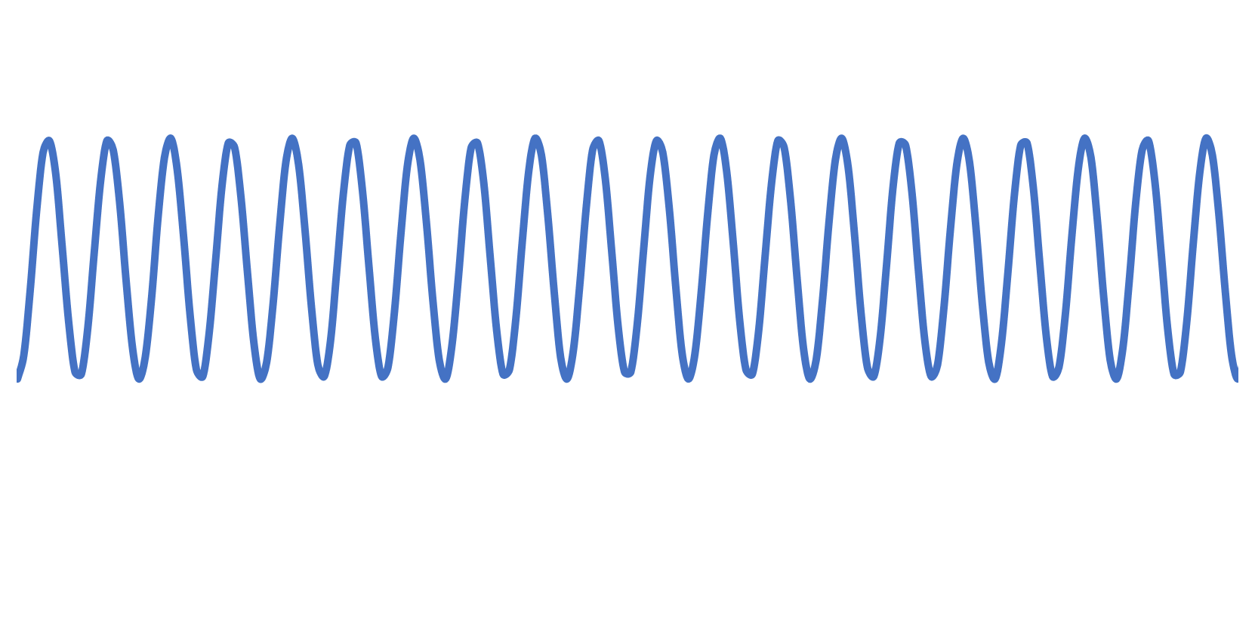
Aliasing of Data
Aliasing occurs when the sampling period approaches the cycling period.
When ablated particulate reaching the ICPMS (mass transport) is washed out between shots of the laser a cycling period is created that matches the laser repetition rate.
You can only observe this on a TOF or using a quadrupole monitoring a single isotope.
If the quad sampling rate is out of sync then aliasing will occur.

Slide 2
20 Hz, 200 ms washout time, 87ms duty cycle
20 Hz overlapping 11.5 Hz
0
1s

Slide 3
20 Hz, 200 ms washout time, 200ms duty cycle
Match duty cycle to rep rate.
20 Hz overlapping 5 Hz
0
1s

Slide 4
20 Hz, 200 ms washout time, 50ms duty cycle
Match duty cycle to rep rate.
20 Hz overlapping 20 Hz
Potential for sync mismatch between samples
0
1s

Slide 5
100 Hz, 200 ms washout time, 50ms duty cycle
Faster rep rate to fill in washout curve
100 Hz puts 5 laser shots in every duty cycle
Maximise shots per duty cycle
0
1s

Slide 6
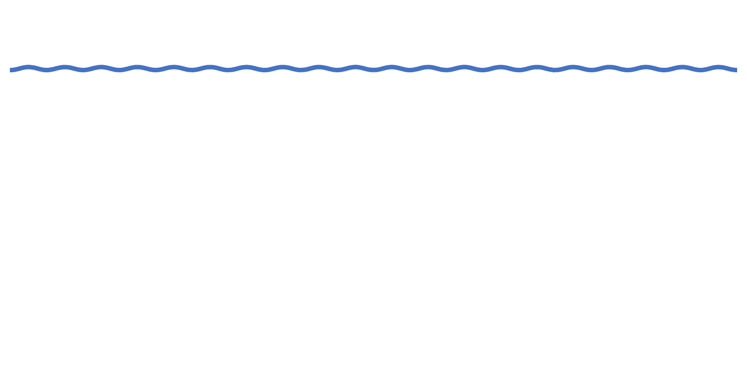
20 Hz, 1000 ms washout time, 87ms duty cycle
Slow down washout speed.
20 Hz at low amplitude – lost in noise of ICPMS
Beware of “smearing” – signal under washout curve,
0
1s

Slide 7
Solutions to Aliasing
Higher repetition rate
Match ICPMS duty cycle to laser rep rate
Use slower washout speed

Slide 8
rhutchinson@icpms.com
iolite@icpms.com
laserapps@icpms.com

